Slide 1
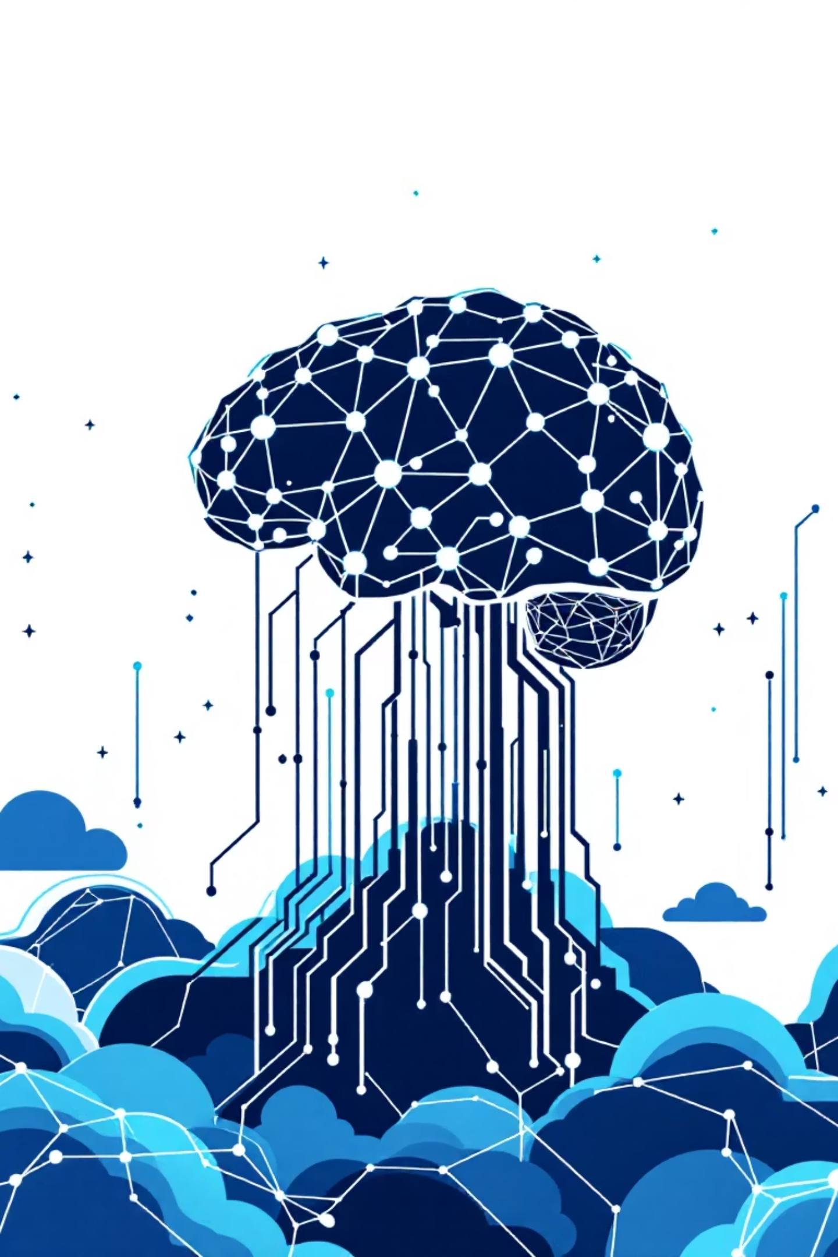
AI-Driven Multi-Agent System for DevOps Automation and Log Analysis
This presentation outlines an innovative approach to DevOps automation through an AI-driven multi-agent system, designed to enhance the reliability and efficiency of modern cloud applications.

Slide 2
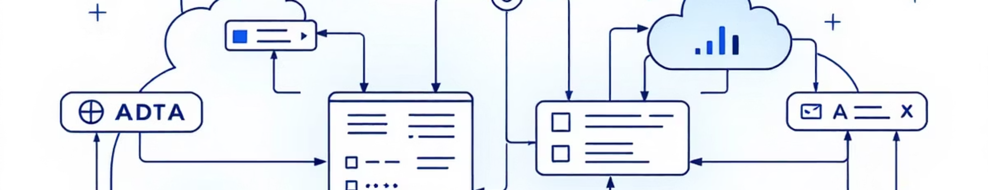
Project Overview: The Complexity of Cloud Operations
Modern cloud applications are inherently complex, generating vast amounts of operational data including logs, metrics, and traces. Traditional, manual DevOps practices are often time-consuming and prone to errors when managing reliability.
Our project introduces an AI-driven multi-agent system capable of autonomously monitoring, analysing, and responding to system issues, emulating the capabilities of a highly skilled Site Reliability Engineer (SRE).

Slide 3

Motivation: The Drive for Intelligent DevOps
Frequent Failures
Alert Fatigue
Cloud systems commonly experience failures, downtime, and performance degradation, impacting service availability.
Rule-based monitoring tools often overwhelm SREs with a deluge of non-critical alerts, leading to fatigue.
Slow RCA
Inefficient Scale
Root Cause Analysis (RCA) remains a largely manual and time-consuming process, delaying resolution.
The increasing scale and complexity of systems render human-only DevOps approaches highly inefficient.
There is a critical need for intelligent, autonomous, and adaptive DevOps systems to address these challenges effectively.

Slide 4
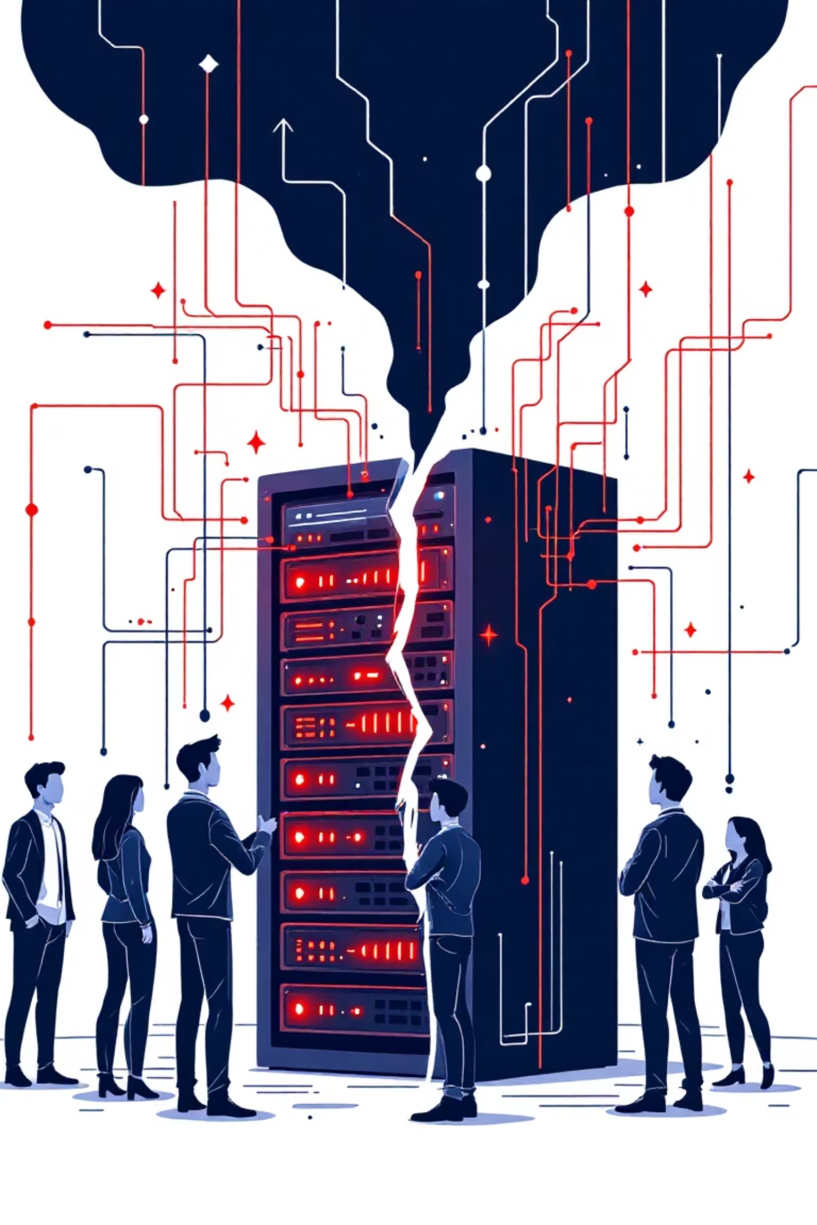
Problem Statement: Limitations of Traditional Monitoring
Traditional DevOps monitoring systems exhibit several key limitations:
Static Thresholds: Reliance on fixed alerts that fail to adapt to dynamic system behaviours.
Limited Log Understanding: Inability to comprehend complex log patterns and derive meaningful insights.
No Automated Remediation: Lack of inherent capabilities for automatic problem resolution.
Absence of Intelligent Decision-Making: Deficiencies in making autonomous, context-aware operational decisions.
Our goal is to construct an AI-based system that can detect anomalies, analyse logs, pinpoint root causes, and initiate automated actions in real-time.

Slide 5

Proposed Solution: A Multi-Agent AI Framework
The proposed system leverages multiple AI agents, each with a specialised function:
Monitoring System Health: Continuously tracking performance and status.
Detecting Anomalies using ML: Identifying unusual patterns that indicate potential issues.
Analysing Logs and Traces: Interpreting operational data to understand system behaviour.
Deciding Corrective Actions: Formulating appropriate responses to detected problems.
Automating Recovery Steps: Executing remediation without human intervention.
These agents collaborate seamlessly to deliver end-to-end DevOps automation.

Slide 6
Multi-Agent Architecture: Core Components
Monitoring Agent
Anomaly Detection Agent
Responsible for the continuous collection of metrics and logs from across the system infrastructure.
Utilises machine learning algorithms to identify abnormal behaviour and potential deviations from baselines.
Root Cause Analysis Agent
Response Agent
Employs AI reasoning frameworks to diagnose the underlying causes of system failures and performance issues.
Determines and executes the most effective remediation actions to resolve identified problems.
All agents communicate via an efficient, event-driven messaging backbone, ensuring swift and coordinated responses.

Slide 7
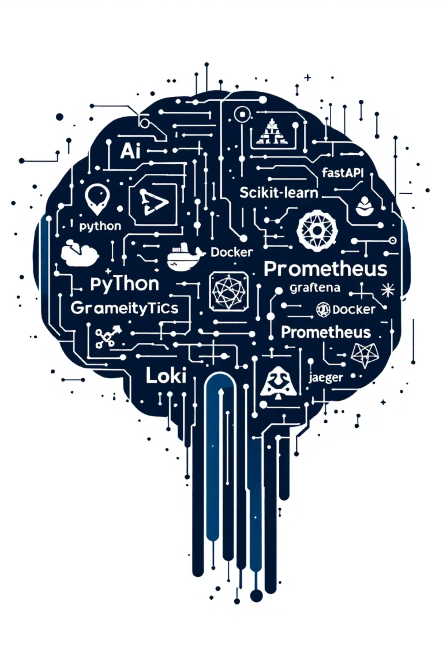
Technologies Employed
Programming & Backend
DevOps & Monitoring
Python: The primary language for agent development.
Docker: Containerisation for scalable and consistent deployments.
FastAPI: For building high-performance APIs and microservices.
Prometheus, Grafana: For metrics collection, visualisation, and alerting.
AI / ML Stack
Loki: Centralised log aggregation and querying.
Scikit-learn, PyTorch: Core libraries for machine learning model development.
Jaeger: Distributed tracing for end-to-end transaction visibility.
Anomaly Detection Algorithms: Custom and established algorithms for pattern recognition.
AI Agents
LLM-based Reasoning: Leveraging advanced Large Language Models for complex decision-making and contextual understanding.

Slide 8



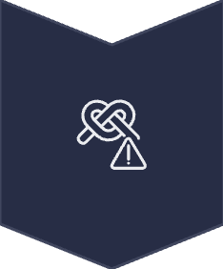


System Workflow: From Anomaly to Resolution
Data Generation
Applications generate vital metrics, logs, and traces.
Real-time Collection
The Monitoring Agent gathers this data continuously.
Anomaly Detection
The Anomaly Agent identifies unusual system behaviours.
Root Cause Analysis
The RCA Agent analyses logs to pinpoint issues.
Automated Remediation
The Response Agent executes corrective actions.
Continuous Learning
System feedback refines future responses and improves models.

Slide 9
Key Features and Advantages
Real-time Monitoring
Intelligent Anomaly Detection
Continuous oversight of system health and performance indicators.
Advanced machine learning for proactive identification of irregularities.
Automated Root Cause Analysis
Self-healing & Auto-remediation
AI-driven diagnosis of underlying problems, speeding up resolution.
Autonomous execution of corrective actions to restore system functionality.
Human-in-the-Loop Control
Scalable Cloud-Native Design
Option for manual oversight and intervention when required.
Built for modern cloud environments, ensuring high availability and elasticity.

Slide 10

Expected Outcomes and Applications
Expected Outcomes
Broad Applications
Reduced MTTD: Significantly decrease Mean Time To Detect issues.
Cloud Infrastructure Management: Streamline operations for complex cloud environments.
Reduced MTTR: Accelerate Mean Time To Recovery for incidents.
DevOps and SRE Automation: Empower teams with advanced autonomous capabilities.
Improved Reliability: Enhance overall system availability and stability.
Enterprise System Monitoring: Provide comprehensive oversight for critical business systems.
Reduced Manual Intervention: Free up SREs for more strategic tasks.
Self-Healing Cloud Platforms: Build resilient platforms that automatically recover from disruptions.
Practical DevOps + AI Integration: Demonstrate the tangible benefits of AIOps.
AI-Powered IT Operations (AIOps): Drive the next generation of intelligent IT management.

Slide 11
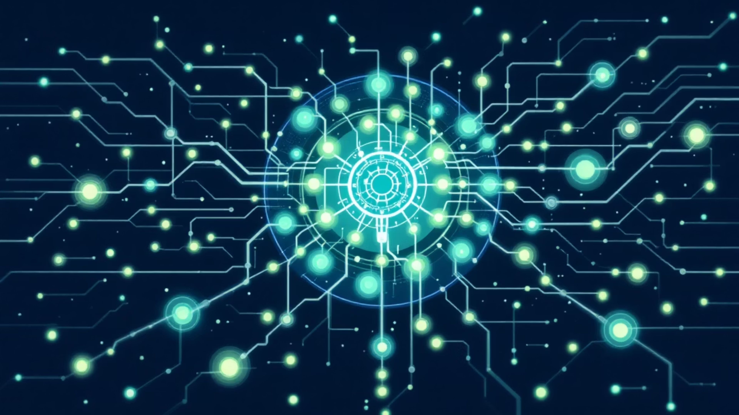
Conclusion: Shaping the Future of DevOps
Intelligent Automation
Enhanced Reliability
Future-Ready AIOps
Our multi-agent AI system revolutionises DevOps by proactively detecting anomalies and autonomously resolving issues, moving beyond traditional reactive monitoring.
By significantly reducing Mean Time To Detect (MTTD) and Mean Time To Recovery (MTTR), we deliver more stable, resilient, and performant cloud operations.
This framework pioneers a new era of AI-powered IT operations, empowering SRE and DevOps teams to focus on innovation rather than manual intervention.

